Slide 1
Applying F#, Improving F#, delivering F#
Don Syme, Phillip Carter

Slide 2
SUMMARY
It’s been a great 12 months!
My preferred way of working is to iterate:
Apply F# in an important area
Learn and digest
Improve F# in incremental but important ways
Please do likewise!

Slide 3
PART I - APPLYING F# TO MOBILE

Slide 4
Part I
fsprojects.github.io/Fabulous

Slide 5
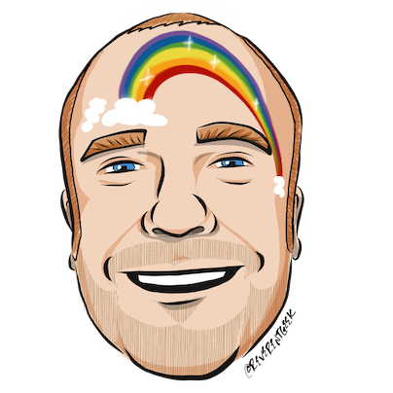






thanks
Timothé Larivière
co-maintainer on Fabulous, author of ElmishContacts and ElmishPlanets demos
Jim Bennett
will talk a bit about using Fabulous and give a demo
Frank Krueger
ImmutableUI was inspiration and initial partial list of Xamarin.Core bindings
Boris D. (github @dboris)
authored “Elmish.Forms” (“half-elmish” for static views only)
Jason Imison
F# in Visual Studio for Mac and Xamarin
Eugene Tolmachev
Creator or “Elmish” for Fable, used for WPF and others
Justin Sacks and others
Creators of “Elmish.WPF” (“half-elmish” for static views only)
Alfonso, Maxime, Steffen and many others
The Fable gang

Slide 6
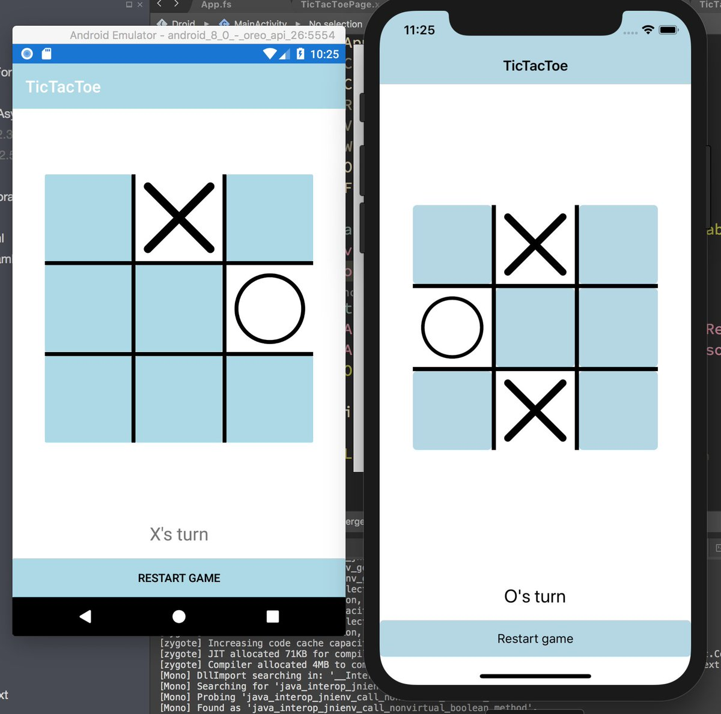
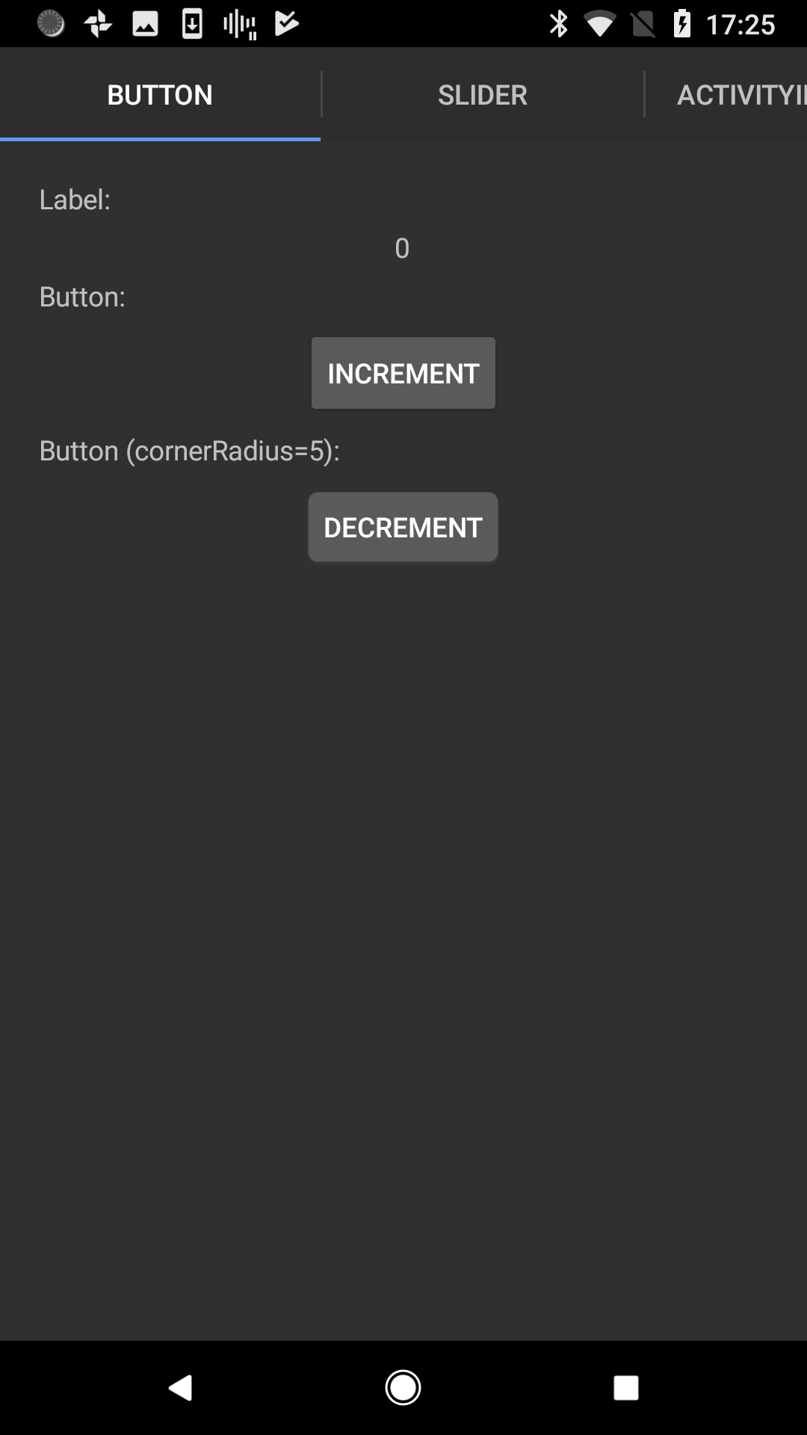
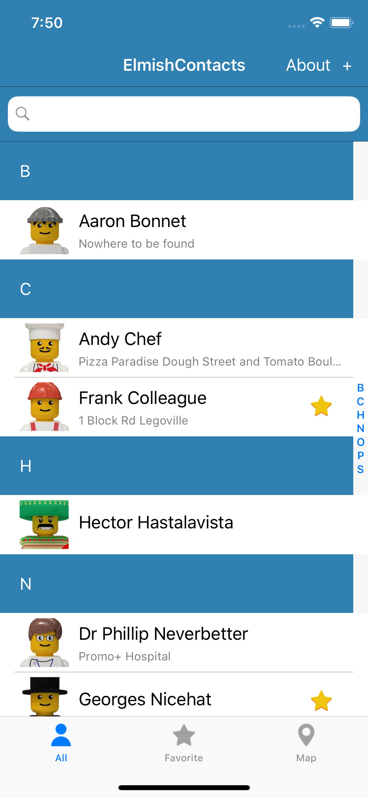
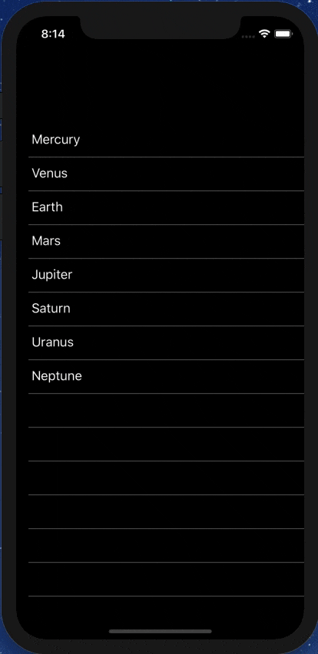
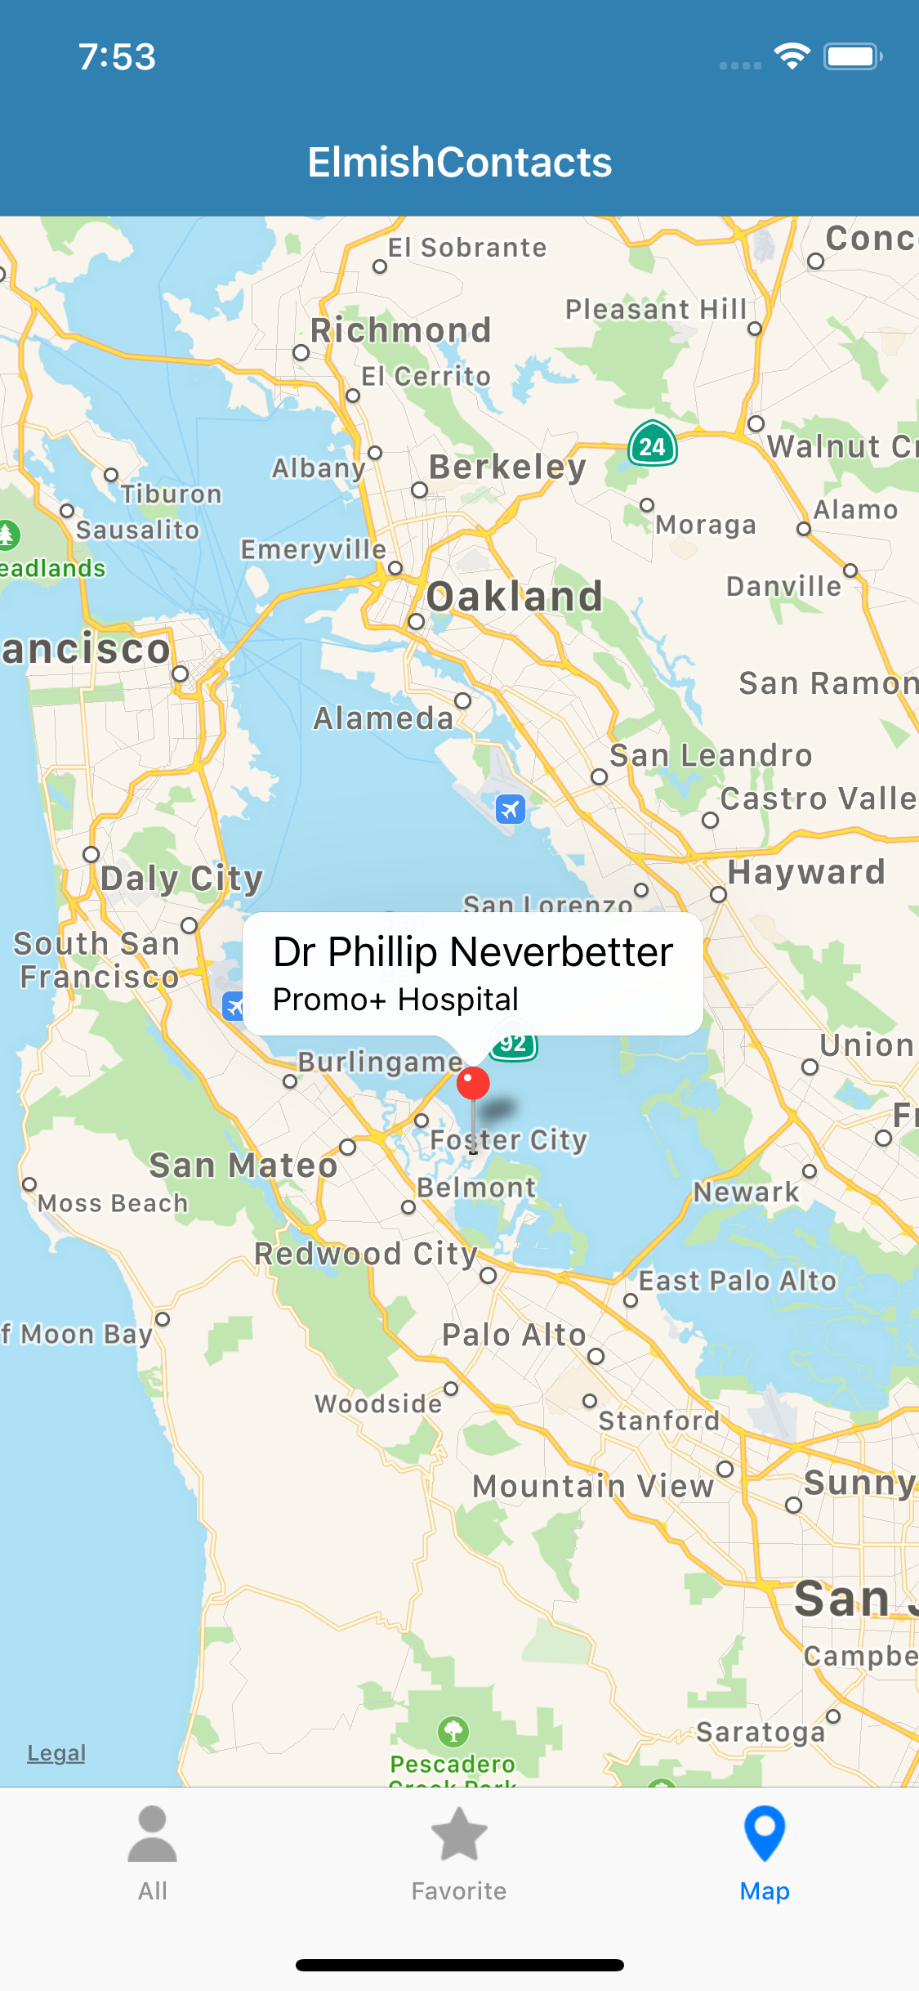



Slide 7
The context
Early F# embraced functional programming but lacked opinion on functional app development
Fable solves this for Web Development
F# developers also need to be able to go mobile.
One question in 2018: Can we make Xamarin a simple and compelling for F# app development?
Notes:
Some good options existed but hadn’t quite taken hold. “winforms designer! WPF designer! Xaml designer on Mac! webforms designer! Xcode designer! Class designer! class browser!”. Some semi-functional architectures too (WebSharper UI.Next, Gjallahorn, others). ReactNative and other options are perceived as being functional-friendly. Can we make Xamarin friendly for F# developers?

Slide 8
THE PROBLEM WITH XAML
A core problem: Xaml
Xaml assumes “designers” will “sliced off” UI from code into a separate DSL.
Xaml is static, with layers of complexity (e.g. templating), and code-like constructs (behaviours, convertors), and requires complex designer tooling (which often fails).
Separating the UI is fine, but do we really need a separate language to do it?

Slide 9
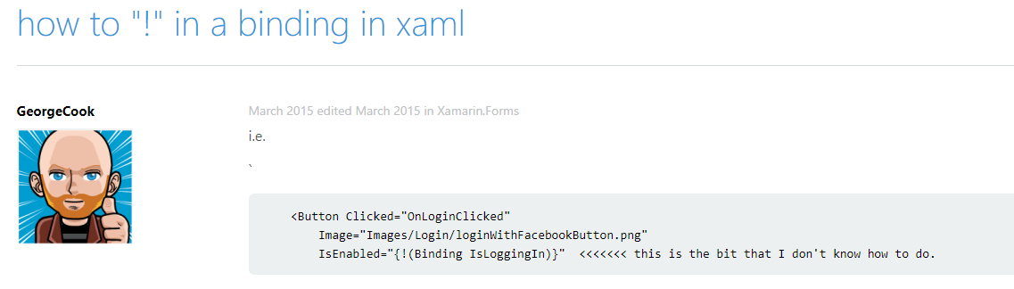
THE PROBLEM WITH XAML

Slide 10
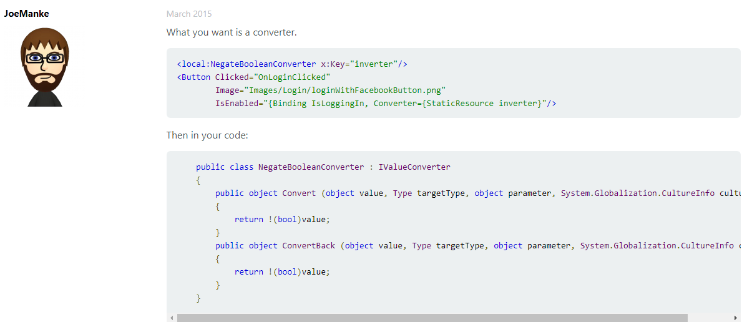
THE PROBLEM WITH XAML

Slide 11
INSPIRATION
Fable has popularized the “Elm” architecture in F#
Fable+Elmish makes web app development simple
All F# code
View descriptions are separated but simple, and in F#
I’m very influenced by SAFE Stack
Non-F# people have found Fable+Elmish easy in business contexts
http://fable.io http://github.com/elmish
https://safe-stack.github.io/

Slide 12
THE NEED
What’s needed?
the simplicity of Fable + Elmish, but for Xamarin
(aside: you can do Fable+Elmish to ReactNative already)

Slide 13
A SIMPLE FABULOUS APP
/// The model from which the view is generated
type Model =
{ Pressed: bool }
/// The messages which cause updates to the model
type Msg =
| Pressed
/// Returns the initial state
let init() =
{ Pressed=false }
/// The function to update themodel
let update (msg: Msg) (model: Model) =
match msg with
| Pressed -> { model with Pressed = true }
/// The function to produce the view elements for a given model
let view (model: Model) dispatch =
if model.Pressed then
View.Label(text="I was pressed!")
else
View.Button(text="Press Me!", command=(fun () -> dispatch Pressed))
type App () as app =
inherit Application ()
let runner =
Program.mkProgram App.init App.update App.view
|> Program.runWithDynamicView app

Slide 14
Getting started
Install Visual Studio
(Mac or Windows with .NET Core and Xamarin enabled)
Create an app
Plug in your Android via USB, enable developer mode, install USB drivers (Windows) etc.
Build/deploy
dotnet new -i Fabulous.Templates
dotnet new fabulous-app -lang F# -n FriedChickenApp
msbuild FriedChickenApp\FriedChickenApp.sln

Slide 15
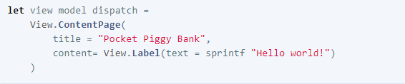
The VIEW DSL
Views are expressed using a DSL
It’s like Xaml, only in F# code.
Lots of named, optional arguments, a fundamental tool for attribute-heavy DSLs in F#.

Slide 16
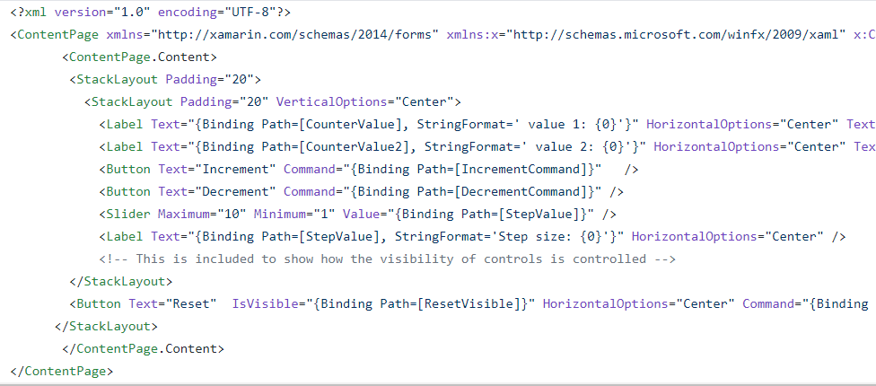
The VIEW DSL
Views are expressed using a DSL
It’s like Xaml, only in F# code and simple

Slide 17
The VIEW DSL
Views are expressed using a DSL
It’s like Xaml, only in F# code and simple
let view (model: Model) dispatch =
View.ContentPage(content=
View.StackLayout(padding=30.0,verticalOptions = LayoutOptions.Center, children=[
View.Label(text= string model.Count, horizontalOptions=LayoutOptions.Center)
View.Button(text="Increment", command= (fun () -> dispatch Increment))
View.Button(text="Decrement", command= (fun () -> dispatch Decrement))
View.Slider(minimum=0.0, maximum=10.0, value=model.Step,
valueChanged= (fun args -> dispatch (SetStep (int args.NewValue))))
View.Label(text=sprintf "Step size: %d" model.Step, horizontalOptions=LayoutOptions.Center)
View.Button(text="Reset", horizontalOptions=LayoutOptions.Center,
command=(fun () -> dispatch Reset), canExecute = (model <> initModel () ))
]))

Slide 18
The VIEW DSL
That original example
let view (model: Model) dispatch =
View.ContentPage(content=
View.StackLayout(padding=30.0,verticalOptions = LayoutOptions.Center, children=[
View.Label(text= string model.Count, horizontalOptions=LayoutOptions.Center)
View.Button(text="Increment", command= (fun () -> dispatch Increment))
View.Button(text="Decrement", command= (fun () -> dispatch Decrement))
View.Slider(minimum=0.0, maximum=10.0, value=model.Step,
valueChanged= (fun args -> dispatch (SetStep (int args.NewValue))))
View.Label(text=sprintf "Step size: %d" model.Step, horizontalOptions=LayoutOptions.Center)
View.Button(text="Reset", horizontalOptions=LayoutOptions.Center,
command=(fun () -> dispatch Reset), canExecute = model.Changed)
]))

Slide 19
The VIEW DSL
That original example
let view (model: Model) dispatch =
View.ContentPage(content=
View.StackLayout(padding=30.0,verticalOptions = LayoutOptions.Center, children=[
View.Label(text= string model.Count, horizontalOptions=LayoutOptions.Center)
View.Button(text="Increment", command= (fun () -> dispatch Increment))
View.Button(text="Decrement", command= (fun () -> dispatch Decrement))
View.Slider(minimum=0.0, maximum=10.0, value=model.Step,
valueChanged= (fun args -> dispatch (SetStep (int args.NewValue))))
View.Label(text=sprintf "Step size: %d" model.Step, horizontalOptions=LayoutOptions.Center)
View.Button(text="Reset", horizontalOptions=LayoutOptions.Center,
command=(fun () -> dispatch Reset), canExecute = not model.Unchanged)
]))
How easy is that?

Slide 20
Further topics
Making it efficient
Extensibility
Maps, Charts, 2D Drawing, 3D Models etc.
Live update tooling
Animation
Lots of View controls
Phone integration (Notifications etc.)
Practical considerations

Slide 21
Making it efficient
let view model dispatch =
…
View.Slider(minimum=0.0, maximum=10.0,
value=double model.Count,
valueChanged=(fun args -> dispatch (SliderValueChanged args.NewValue)))
…

Slide 22
Making it efficient
let view model dispatch =
…
dependsOn (…) (fun model (count, step) ->
…
)
…

Slide 23
Making it efficient
let view model dispatch =
…
dependsOn (model.Count, model.Step) (fun model (count, step) ->
View.Slider(minimum=0.0, maximum=10.0,
value=double count,
valueChanged=(fun args -> dispatch (SliderValueChanged args.NewValue))))
…

Slide 24
ELMISH CONTACTS

Slide 25
LEARN!
ElmishContacts is a great example
On-device per-app SQL-Lite integration
Using maps
Asynchronous data loading onto maps
Catching exceptions and being robust
Sending SMS, making phone calls and Email using Xamarin.Essentials
Multi-page with external messages reconciled via the composed app
Editing and searching lists of things
Taking photos
Splash screens
Decent design

Slide 26
Live update
An experimental LiveUpdate mechanism is available
F# code for the core of your app is recompiled on host and interpreted on device
Communication to device via adb/http
Update times ~2sec
Current limitations (please help!)
No state-migration as yet
Some manual start-up steps
DEBUG mode only
Some bugs/limitations in on-device interpreter
Some differences in semantics for on-device interpreter (e.g. typeof)

Slide 27
SUMMARY
Fabulous
=
Simple F#-friendly Elmish-style Functional Mobile App Programming
Please contribute and get involved!

Slide 28
Resources
fsprojects.github.io/Fabulous
View snippets
Docs
Links to Samples
Templates
How to use LiveUpdate (for small apps)
The AllControls sample
Awesome-Fabulous
Xamarin.Essentials
Xamarin docs (e.g.Forms, Android, iOS setup and deploy)

Slide 29
PART II - APPLYING F# TO AI
Don Syme, Phillip Carter

Slide 30
Recap
.NET
Python
C++
Java
JS
General Purpose
Development
(C#, C++, JS, Java, ½ Python)
5000
Statistics and
Data Science
500
(numpy, pandas, matlab, R)
Data Scripting
500
( ½ Python, ¼ bash, ¼ powershell)
Source: #Stackoverflow tags
Machine Learning
200
(TensorFlow, PyTorch, Keras, ½ numpy)
Systems Scripting
150
( ¾ Powershell, ¾ bash)

Slide 31
Situation
Deep Learning is a critical, rapidly expanding part of the AI and ML landscape
Deep Learning frameworks are programming languages (e.g. TensorFlow)
There appears to be a “Gen 2.0” to “Gen 3.0” transition going on
TF 1.0 → 2.0
New host languages (e.g. Google Swift)
Google Jax integrates tensors, gradients and control flow with Python code
DL is expanding out from “static graphs”
Many new ideas in DL architecture (e.g. Bayesian loss functions)

Slide 32
Problems
Realistically, Gen 3.0 will be an evolution of Gen 2.0
There is no single revolution
Change is happening on many fronts
Language expressivity is a pain point for some advanced modelling
Expert practitioners deeply wedded to current ecosystems (Python, TensorFlow, Torch)
Majority of creativity will happen in these ecosystems
Practitioners experience real pain with Tensor programming
A lack of types makes Python Deep Learning (and data scripting) HARD and limits expressivity
Many, many shape mistakes
Incorrect striding
Subtle errors in missing layers, incorrect use of weights

Slide 33
Need
Value can come in many areas
Better host languages (Swift, F#, Better Python…)
Better expressivity for Models…
Better checking of Models…
Better tooling for Models…
Better algorithms for Training….
Better cloud Hardware, Provisioning and Execution…

Slide 34
“F# for AI Models” - A sketch, not a reality
A new take on authoring AI models in F#?
A “configuration” of F#?
Fable and SAFE has shown how we can configure F# for a domain
Assume latest language features, default libraries
Assume ReflectedDefinition on all model code
Deeply integrate gradient-based techniques
TensorFlow and Torch for real-world use
DiffSharp 1.0 as a more expressive fabric for auto-gradients?
Nested AD, recursive operations?
Tooling for correct, robust AI Model Development?
Make it fit with both .NET and Python (ML.NET, REPL, Jupyter Notebooks, Spark, …)

Slide 35
FM “v0.01” constructs
Shape inference, checking and tooling
Differentiable Tensors
Variables, Placeholders
Constants, Broadcasting, Slicing, Indexing
Standard math operators (+,*,-,/,abs,sin,cos,tan,sqr,sqrt…)
Reductions (mean,sum,prod,min,max,…)
Convolutions (2D, batched)
Gradients
diag, norm,trace, …
V0.02 (tentative)
control flow
quotations
complete operations
Torch/DiffSharp backend

Slide 36
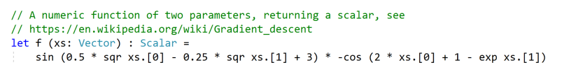
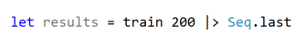
Results: Micro-example
#r "nuget: FSharp.AI.Models, Version=0.1"

Slide 37
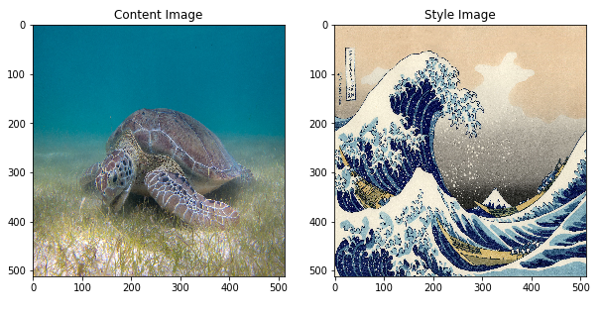
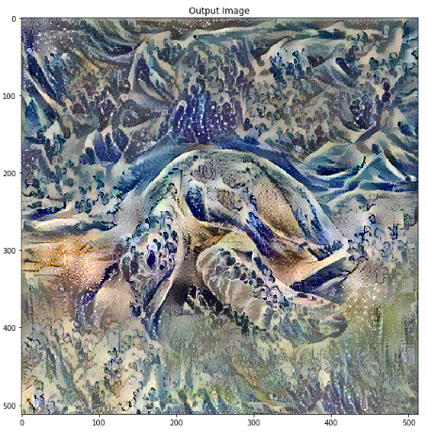
Results: Macro-example
Explaining and Neural Style Transfer
Demo
Use the DNN
Train a DNN

Slide 38
Tooling for Tensor Shapes
One holy grail of DNN programming tooling is tensor shape checking
Tensors are multi-dimensional arrays used to represent source and emergent data
Tensors have shapes like “10 x 320 x 720 x 4”
Logical these shapes are symbolic like “N x H x W x C”
Your choices:
No checking = lots of bugs
Use type system = extreme complexity
A new choice!
Use live checking = live testing + checking collecting information for tooling

Slide 39
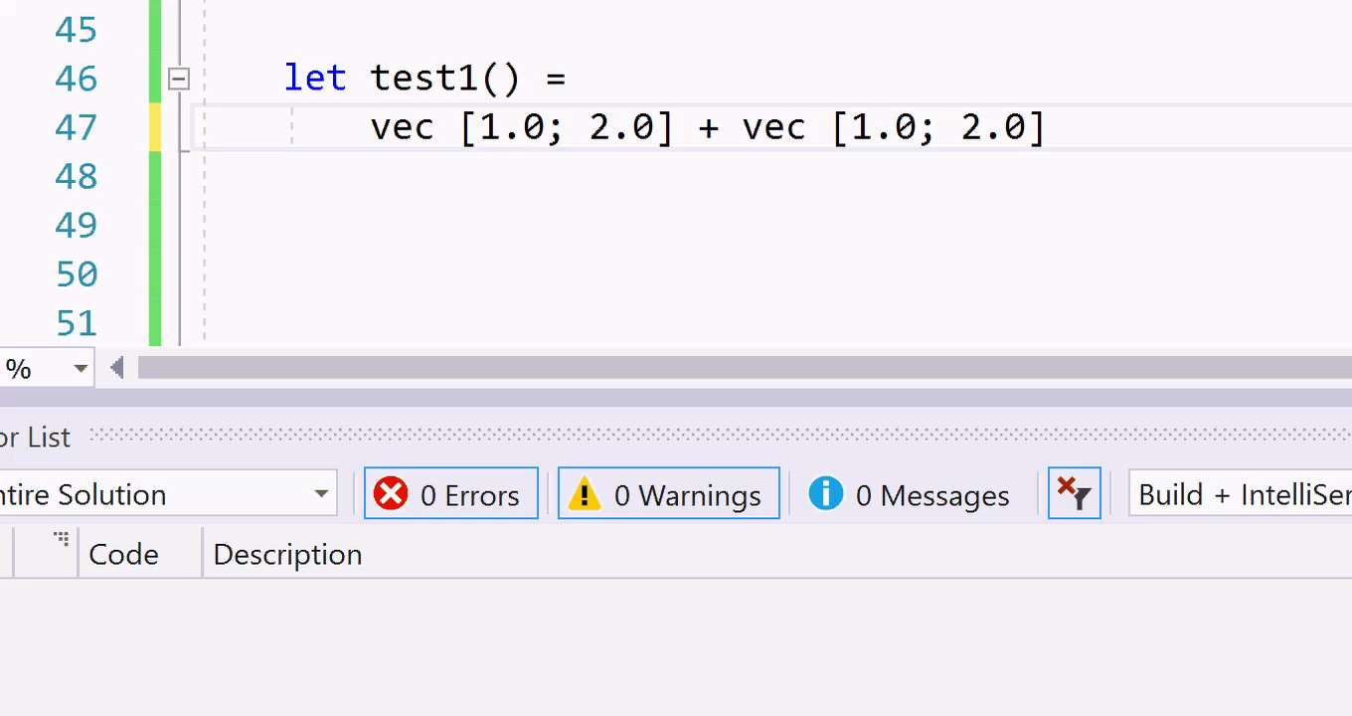
Tooling for Tensor Shapes: demo
Explaining and Using Deep Learning
Finding a shape bug

Slide 40
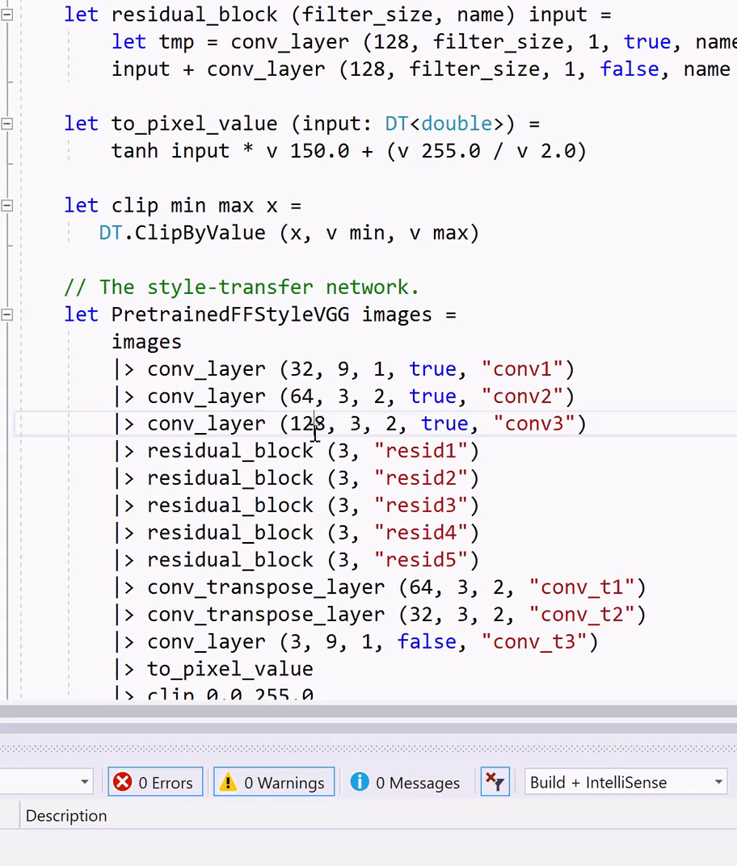
Tooling for Tensor Shapes: demo
Explaining and Using Deep Learning
Finding a shape bug

Slide 41
Tooling for Tensor Shapes
Results
Static TensorShape checking alone gets the interest of DNN experts.
With this we are already world-leading in this area
Anecdotal: helps explain Deep Learning to 13 yr olds (my son)
It’s applied to Gen 2.0 models, but will work just as well with Gen 3.0
Aside: The LiveChecking technique has many potential applications
It’s not full types, but it doesn’t matter – it’s statically checked and tooled
Checking ML.NET schema in pipeline composition
Checking other DSLs

Slide 42
Next Steps
This was experimental investigation, it’s my job.
This is not remotely ready for production, I’m just having investigating
Don’t let this disrupt your world view!
To watch: SciSharp. We will switch to their TensorFlow.NET

Slide 43
IMPROVING F#
Don Syme, Phillip Carter

Slide 44
F# 4.6
Currently in Preview and ships with VS 2019 GA
And corresponding .NET Core 2.1 and 2.2 updates
Anonymous Records
Supported in Fable too!
FSharp.Core improvements
ValueOption function parity

Slide 45
F# 5.0 – Nullable reference types
F# has little problem with nulls. C# has a massive problem.
Today:
F# types do not have null as a normal value.
.NET types do, but it is rare to encounter null values flowing out of .NET libraries.
C# is trying to make progress on this problem by adding “use-site nullness annotations”
.NET libraries will have nullness annotations. We can make use of this

Slide 46
F# 5.0 – Nullable reference types
Design philosophy
Design for F# first. Make sure it “looks right” as an F# language feature
Keep F# simple. The feature will be rarely used in F#. You will only use this feature when using .NET libraries and “null”.
This is a warning-level informational feature. It is not a strong “soundness” feature, but a helpful aid.
option/Some/None remains the normal way to represent missing information in F#.
Warnings only activated for new projects (/langversion:5.0)

Slide 47
F# 5.0 – Nullable reference types
Constructs:
Types:
string? - has null as a normal value
string - does not have null as a normal value
let s1 : string = null // warning
let s2 : string? = if today then "abc" else null // ok
match s with
| NonNull v -> …
| null -> …
Introduction:
Elimination:

Slide 48
F# 5.0 – Nullable reference types
Refinements, see RFC
Library functions withNull, isNull, nonNull and more
“Ambivalence” for types coming from non-annotated .NET assemblies
“obj” is always ambivalent
Possible simpler ways to eliminate

Slide 49
F# 5.0 – other things
Possible items:
FS-1070: Relax indentation warnings
FS-1043: Extension methods visible to trait constraints
FS-1069: Implict yields (for Fable and Fabulous)
FS-1068: Open static classes (for Fable, Fabulous and Spark)
FS-1003: nameof operator
FS-1071: Witness passing info in quotations (for Fable and “F# for AI Models”)
FS-1063: Applicatives syntax in computation expressions “let! … and! …”
FS-1056: Overloads of custom operators in computation expressions

Slide 50
DELIVERING F#
A Chat with Phillip Carter

Slide 51
Delivering f#
Topics:
Delivery in .NET SDK 2.1, 2.2
FSharp.Compiler.Service and Fable up-to-date and community delivered. Mono lagging a little.
Towards Visual Studio 2019
Towards .NET SDK 3.0

